Slide 1
Object Oriented Programming Lecture-11
java.util.Arrays class, string class
Prof. Varsha Dange

Slide 2
java.util.Arrays class
Arrays class was introduced in JDK 1.2 version.
This class contains various methods for manipulating arrays such as sorting, searching, copying, converting an array to string and etc.
It belongs to java.util package.

Slide 3
Methods of Arrays class
Method | Purpose
Arrays.toString() | To convert single dimensional array to string.
Arrays.deepToString() | To convert multi-dimensional array to string.
Arrays.sort() | To sort array in ascending order.
Arrays.parallelSort() | Similar to Arrays.sort() (mainly for multiple thread).
Arrays.copyOf() | To copy the complete array to another array.
Arrays..copyOfRange() | Similar to Arrays.copyOf() but copy only within the given range.
Arrays.equals() | For equality testing of two arrays.
Arrays.deepEquals() | For equality testing given two arrays deeply.
Arrays.hashCode() | To give hash code based on the contents of the specified array.
Arrays.deepHashCode() | To give hash code based on the “deep contents” of given array.
Arrays.compare() | Compares two specified arrays lexicographically.

Slide 4
Methods of Arrays class
Method | Purpose
Arrays.compareUnsigned() | Compares two arrays lexicographically, numerically treating elements as unsigned.
Arrays.setAll() | It set all elements of the specified array.
Arrays.parallelSetAll() | Set all elements of the specified array, in parallel.
Arrays.fill() | To fill array elements with given value.
Arrays.stream() | To return stream for the specified array.
Arrays.asList() | To return array as List.
Arrays.binarySearch() | Find index of array element.
Arrays.mismatch() | To return the index of the first mismatch between the two arrays.
Arrays.spliterator() | It returns a Spliterator covering all of the specified array.
Arrays.parallelPrefix() | It performs a given mathematical function on the elements of the array cumulatively, and them modifies the array concurrently.

Slide 5
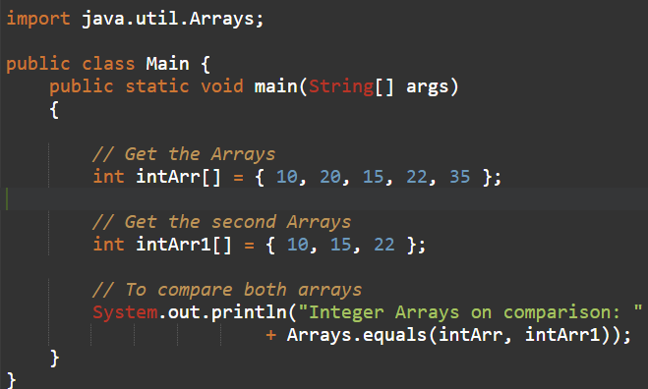
Methods of Arrays class
Example
Output:

Slide 6
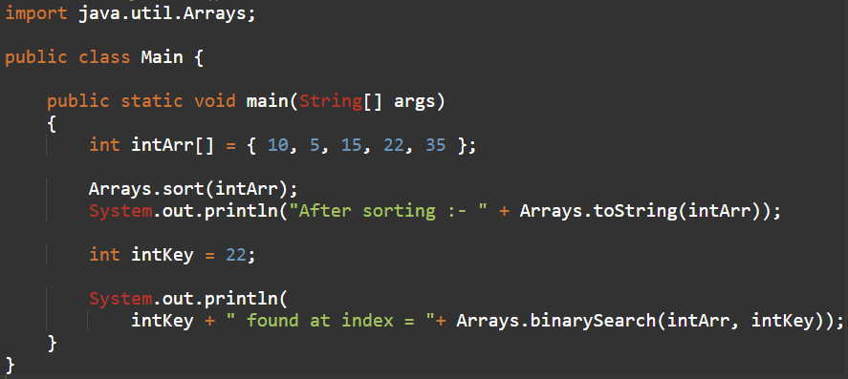

Methods of Arrays class
Example
Output:

Slide 7
String class in Java
Generally, String is a sequence of characters.
But in Java, string is an object that represents a sequence of characters.
String class is used to create a string object.
It is a predefined immutable class that is present in java.lang package.

Slide 8
How to create String object in Java?
To handle string data in Java, we need an object of string class.
ways to create a String object in Java.
By string literal.
By new keyword.

Slide 9
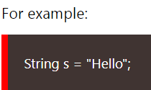
String literal in Java
String literal in Java is created by using double quotes.
The string literal is always created in the string constant pool.
In Java, String constant pool (SCP) is a special area that is used for storing string objects.
SCP is a part of Heap memory area.

Slide 10
String literal in Java
Whenever we create a string literal in Java, JVM checks string constant pool first.
If the string already exists in string constant pool , no new string object will be created in the string pool by JVM.
JVM uses the same string object by pointing a reference to it to save memory.
But if string does not exist in the string pool, JVM creates a new string object and placed it in the pool.

Slide 11
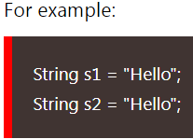
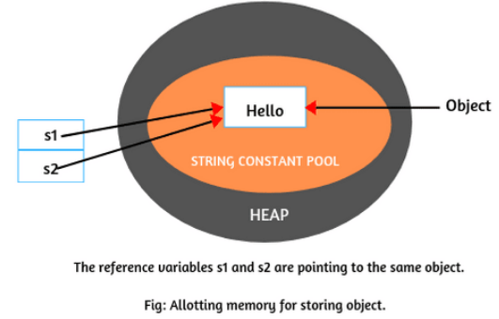
String literal in Java
when JVM will execute the 1st statement, it will not find any string with value “Hello” in the string constant pool.
So, it will create an object in string pool and store string “Hello” in that object and it referenced by the reference variable s1.
When JVM will execute the 2nd statement, and first check to SCP whether same content is already available there or not.
Since string with value “Hello” is already available in the string pool.
So, JVM will not create a new string object in the pool, and the address of the available object will assign to reference variable s2.

Slide 12

Creating String Object by new Keyword
The second way of creating an object to string class is by using new operator.
It is just like creating an object of any class.
Whenever we create an object of string class using the new operator, JVM will create two objects.
First, it will create an object in the heap area and store string “Hello” into the object.
After storing data into memory, JVM will point a reference variable s to that object in the heap.
Allocating memory for string objects is shown in the below figure.

Slide 13
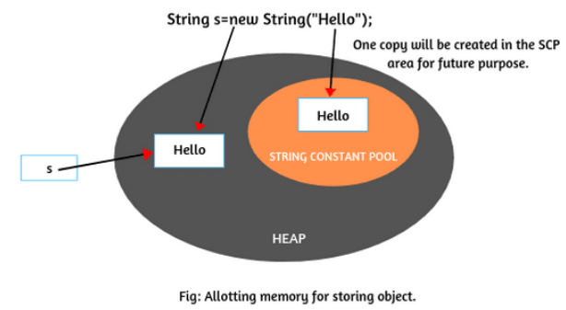
Creating String Object by new Keyword
Now JVM will create the second object as a copy for literal “Hello” in string constant pool for future purposes.
There is no explicit reference variable pointing to the copy object in the pool
but internally, JVM maintains the reference variable implicitly.
the object created in the SCP area is not eligible for garbage collection because implicitly, the reference variable will be maintained by JVM itself.
Key point:
For every string literal, one copy will be created in the SCP area.
Example

Slide 14


By converting Character Arrays into String
The third way to create strings is by converting the character arrays into string.
For eg. character type array: arr[ ] with some characters as given:
Now create a string object by passing array name to string constructor like this:
Now string object contains string “java”. It means that all the characters of the array are copied into string.

Slide 15
String class in Java
Key points: Example
Strings are objects in Java.
once a String object has been created, we cannot change any characters in string. Therefore, string object is immutable in Java.
The number of characters in a string is called length of string.
For eg, the length of “Hello” is 5.
String class in Java has numerous methods for string manipulation.
String is not a primitive data type. It is a reference data type.

Slide 16
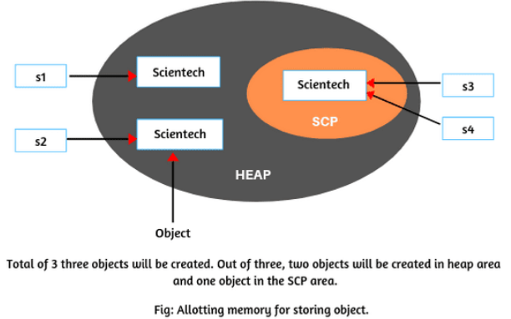
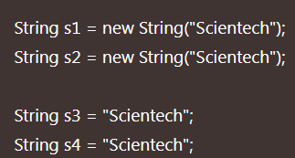
String class in Java
How many total objects will be created in memory for following string objects?

Slide 17
Immutable String in Java
String class in Java is immutable. The meaning of immutable is unchangeable or unmodifiable.
we cannot modify the value of the string.
But if you try to change with a new value, a new string object will be created by storing a new value.
Java implements this immutability concept to minimize the duplication of string values and can save space in the memory by sharing strings.
Example

Slide 18
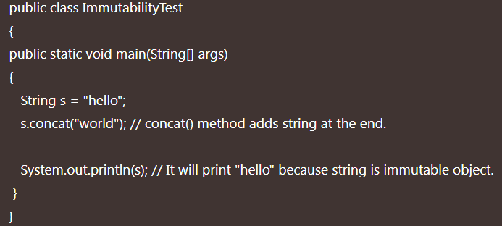

Immutable String in Java

Slide 19
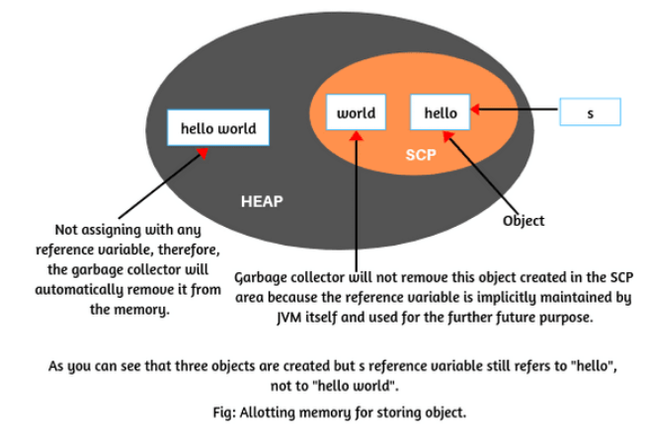
Immutable String in Java
When JVM will execute statement String s = “hello”;, it will create a string object in the string constant pool and store “hello” in it.
When the next statement s.concat (“world”); will be executed by JVM,
it will create two new objects
First, for string literal “world”, JVM will create one copy of string object in the string constant pool.
second object will be created in the heap with modified content “hello world”.
Since string concatenation is executed at the runtime.

Slide 20
Immutable String in Java
Since this new object is not assigning with any reference variable,
therefore, it is called unreferenced object and
the garbage collector will automatically remove it from the memory.
Thus, the value of string s is not modified and still, ‘s’ is pointing to “hello” only.
Therefore, the result is “hello”.
This is the reason, string objects are called immutable in Java.
Key point: Example
1. String concatenation cannot be resolved at the compile time. It is always executed at runtime. This causes an extra object to be generated.

Slide 21
Immutable String in Java
Why String objects are immutable in Java?
String objects are immutable in Java because Java uses the concept of string constant pool.
Suppose there are 6 reference variables, and pointing to the same object “Hello world”.
If one reference variable of them changes the value of object from “Hello world” to “Hello”, with this change, all the reference variables will be affected.
That’s why string objects are immutable in Java.

Slide 22
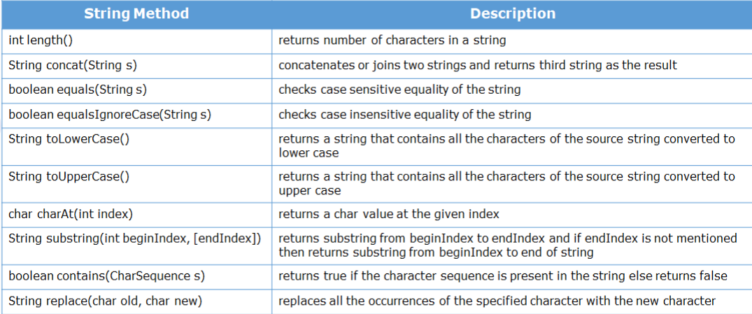
String Methods in Java
String class provides many useful methods to perform various operations.
Example

Slide 23
String Question
What will be the output of the below code?
class Main{
public static void main(String[] n) {
String s1 = new String("abc");
String s2 = "abc";
String s3 = "abc";
if (s1==s2) System.out.println("s1==s2");
if(s1==s3) System.out.println("s1==s3");
if(s2==s3) System.out.println("s2==s3");
}}
s2==s3

Slide 24
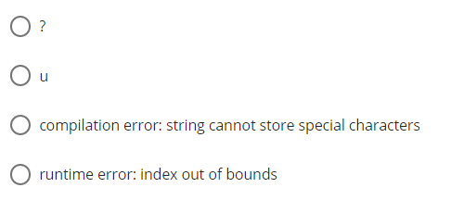
String Question
What will be the output of the below code?
public class Tester {
public static void main(String args[]) {
String str = "How Are You?";
System.out.println(str.charAt(str.length()));
}
}
Option runtime error: index out of bounds is Correct

Slide 25
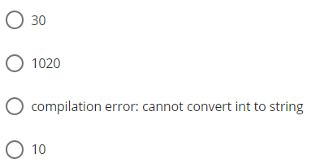
String Question
What will be the output of the below code?
public class Tester {
public static void main(String args[]) {
String num = "10";
int n = 20;
System.out.println(num + n);
}
}
Option 1020 is Correct

Slide 26
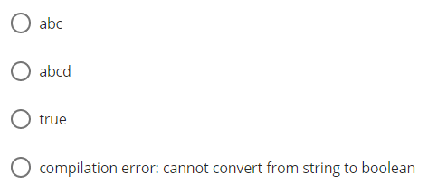
String Question
What will be the output of the below code?
public class Tester {
public static void main(String args[]) {
String s1 = "abc";
String s2 = "abcd";
System.out.println(s1 = s2);
}
}
Option abcd is Correct

Slide 27
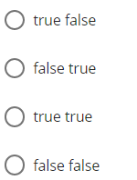
String Question
What will be the output of the below code?
public class Tester {
public static void main(String args[]) {
String s1 = "abc";
String s2 = new String("abc");
System.out.println(s1.equals(s2));
System.out.println(s1 == s2);
}
}
Option true false is Correct

Slide 28
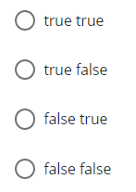
String Question
What will be the output of the below code?
public class Tester {
public static void main(String[] args) {
String passengerFirstName = "James";
String p1 = passengerFirstName.toUpperCase();
System.out.println(p1.equals(passengerFirstName));
System.out.println(p1.equalsIgnoreCase(passengerFirstName));
}
}
Option false true is Correct

Slide 29
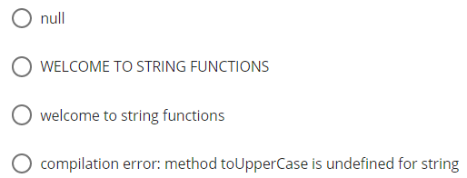
String Question
What will be the output of the below code?
public class Tester {
public static void main(String args[]) {
String input = "welcome to string functions";
input.toUpperCase();
System.out.println(input);
}
}
Option welcome to string functions is Correct

Slide 30
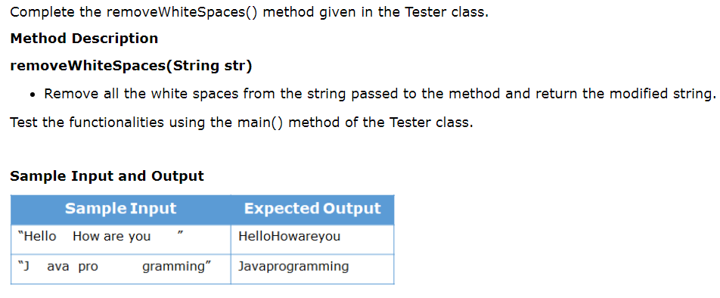
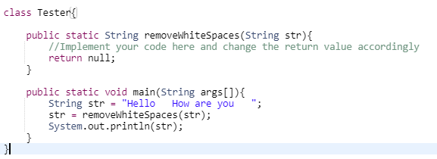
String Question

